Slide 1
Priority Queue and Heap

Slide 2
BINARY HEAP

Slide 3
Binary Heaps
The (binary) heap data structure is an array object that can be viewed as a complete binary tree.
Each node of the tree corresponds to an element of the array that stores the value in the node.
The tree is completely filled on all levels except possibly the lowest, where it is filled from the left up to a point.
Despite the fact that it is in fact an array.
We will imagine the entire data structure to be a tree.

Slide 4
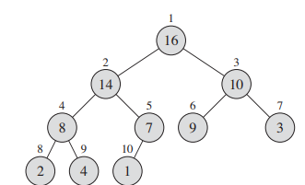
Binary Heaps
How can we visualize this array as a complete binary tree?
1 | 2 | 3 | 4 | 5 | 6 | 7 | 8 | 9 | 10
16 | 14 | 10 | 8 | 7 | 9 | 3 | 2 | 4 | 1

Slide 5
Binary Heaps
Some basic variables and functions of a heap:
A.heap-size
A.length
PARENT(i)
LEFT(i)
RIGHT(i)
Let us observe the array again
1 | 2 | 3 | 4 | 5 | 6 | 7 | 8 | 9 | 10
16 | 14 | 10 | 8 | 7 | 9 | 3 | 2 | 4 | 1

Slide 6
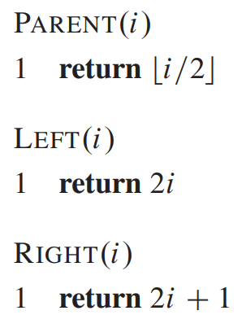
Binary Heaps
Question: Who is the parent of the 7th array element?
Answer:
We can draw the tree and find out
We can use these functions and determine directly
1 | 2 | 3 | 4 | 5 | 6 | 7 | 8 | 9 | 10
16 | 14 | 10 | 8 | 7 | 9 | 3 | 2 | 4 | 1

Slide 7
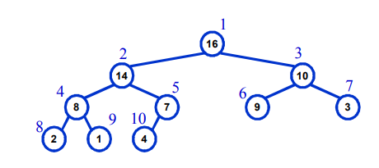
Max Heap and Min Heap
Max-Heaps
Satisfies the heap property: A[Parent(i)] >= A[i] for all nodes i > 1
The value of a node is at most the value of its parent
The largest element in a max-heap is stored at the root
Where is the smallest element ?
Ans: At one of the leaves [leaf indices are n/2+1 to n]

Slide 8
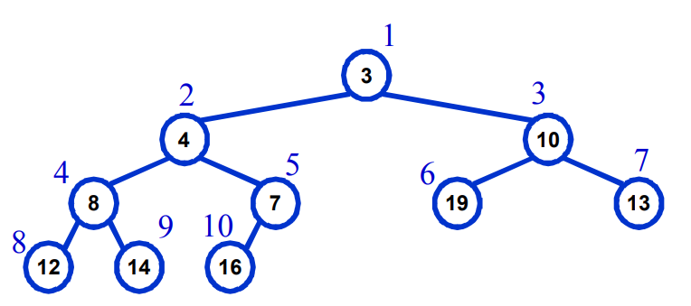
Max Heap and Min Heap
Min-Heaps
Satisfies the heap property: A[Parent(i)] <= A[i] for all nodes i > 1
The value of a node is at least the value of its parent
The smallest element in a max-heap is stored at the root
Where is the largest element ?
Ans: At one of the leaves [leaf indices are n/2+1 to n]

Slide 9
Important Functions of Max Heap
MAX-HEAPIFY –
O(lg n) time
Tries to make the array into a heap
BUILD-MAX-HEAP
O(n) time
Converts an array into a heap
HEAPSORT
O (n lg n) time
Another sorting algorithm
Makes use of the concept of heap
Priority Queue functions
MAX-HEAP-INSERT
HEAP-EXTRACT-MAX
HEAP-INCREASE-KEY
HEAP-MAXIMUM
run in O(lg n) time

Slide 10
MAX HEAPIFY
Tries to make the array into a max heap
(parent value>= child value)
MaxHeapify(A,index)
1
16
3
1 | 2 | 3 | 4 | 5 | 6 | 7 | 8 | 9 | 10
16 | 4 | 10 | 14 | 7 | 9 | 3 | 2 | 8 | 1
2
4
10
4
5
6
7
14
7
9
3
8
9
10
2
8
1

Slide 11
MAX HEAPIFY
Tries to make the array into a max heap
(parent value>= child value)
MaxHeapify(A,index)
1 | 2 | 3 | 4 | 5 | 6 | 7 | 8 | 9 | 10
16 | 4 | 10 | 14 | 7 | 9 | 3 | 2 | 8 | 1
1
16
3
2
4
10
4
5
6
7
14
7
9
3
8
9
10
2
8
1

Slide 12
MAX HEAPIFY
Tries to make the array into a max heap
(parent value>= child value)
MaxHeapify(A,index)
1 | 2 | 3 | 4 | 5 | 6 | 7 | 8 | 9 | 10
16 | 4 | 10 | 14 | 7 | 9 | 3 | 2 | 8 | 1
1
16
3
How the function works:
It is applied on an index.
It checks if the parent is greater than the child
If the parent is greater, return.
If the child is greater, then swap values with child
Run the function on the child (recursively)
2
4
10
4
5
6
7
14
7
9
3
8
9
10
2
8
1

Slide 13
MAX HEAPIFY
Tries to make the array into a max heap
(parent value>= child value)
MaxHeapify(A,index)
1 | 2 | 3 | 4 | 5 | 6 | 7 | 8 | 9 | 10
16 | 4 | 10 | 14 | 7 | 9 | 3 | 2 | 8 | 1
1
16
MaxHeapify(A,2)
3
How the function works:
It is applied on an index.
It checks if the parent is greater than the child
If the parent is greater, return.
If the child is greater, then swap values with child
Run the function on the child (recursively)
2
4
10
4
5
6
7
14
7
9
3
8
9
10
2
8
1

Slide 14
MAX HEAPIFY
Tries to make the array into a max heap
(parent value>= child value)
MaxHeapify(A,index)
1 | 2 | 3 | 4 | 5 | 6 | 7 | 8 | 9 | 10
16 | 4 | 10 | 14 | 7 | 9 | 3 | 2 | 8 | 1
1
16
MaxHeapify(A,2)
3
How the function works:
It is applied on an index.
It checks if the parent is greater than the child
If the parent is greater, return.
If the child is greater, then swap values with child
Run the function on the child (recursively)
2
4
10
4
5
6
7
Largest
14
7
9
3
8
9
10
2
8
1

Slide 15
MAX HEAPIFY
Tries to make the array into a max heap
(parent value>= child value)
MaxHeapify(A,index)
1 | 2 | 3 | 4 | 5 | 6 | 7 | 8 | 9 | 10
16 | 4 | 10 | 14 | 7 | 9 | 3 | 2 | 8 | 1
1
16
MaxHeapify(A,2)
3
How the function works:
It is applied on an index.
It checks if the parent is greater than the child
If the parent is greater, return.
If the child is greater, then swap values with child
Run the function on the child (recursively)
2
4
10
4
5
6
7
Largest
14
7
9
3
8
9
10
2
8
1

Slide 16
MAX HEAPIFY
Tries to make the array into a max heap
(parent value>= child value)
MaxHeapify(A,index)
1 | 2 | 3 | 4 | 5 | 6 | 7 | 8 | 9 | 10
16 | 4 | 10 | 14 | 7 | 9 | 3 | 2 | 8 | 1
1
16
MaxHeapify(A,2)
3
How the function works:
It is applied on an index.
It checks if the parent is greater than the child
If the parent is greater, return.
If the child is greater, then swap values with child
Run the function on the child (recursively)
2
4
10
4
5
6
7
14
7
9
3
8
9
10
2
8
1

Slide 17
MAX HEAPIFY
Tries to make the array into a max heap
(parent value>= child value)
MaxHeapify(A,index)
1 | 2 | 3 | 4 | 5 | 6 | 7 | 8 | 9 | 10
16 | 14 | 10 | 4 | 7 | 9 | 3 | 2 | 8 | 1
1
16
MaxHeapify(A,2)
3
How the function works:
It is applied on an index.
It checks if the parent is greater than the child
If the parent is greater, return.
If the child is greater, then swap values with child
Run the function on the child (recursively)
2
14
10
4
5
6
7
4
7
9
3
8
9
10
2
8
1

Slide 18
MAX HEAPIFY
Tries to make the array into a max heap
(parent value>= child value)
MaxHeapify(A,index)
1 | 2 | 3 | 4 | 5 | 6 | 7 | 8 | 9 | 10
16 | 14 | 10 | 4 | 7 | 9 | 3 | 2 | 8 | 1
1
16
3
How the function works:
It is applied on an index.
It checks if the parent is greater than the child
If the parent is greater, return.
If the child is greater, then swap values with child
Run the function on the child (recursively)
2
14
10
MaxHeapify(A,4)
4
5
6
7
4
7
9
3
8
9
10
2
8
1
Largest

Slide 19
MAX HEAPIFY
Tries to make the array into a max heap
(parent value>= child value)
MaxHeapify(A,index)
1 | 2 | 3 | 4 | 5 | 6 | 7 | 8 | 9 | 10
16 | 14 | 10 | 4 | 7 | 9 | 3 | 2 | 8 | 1
1
16
3
How the function works:
It is applied on an index.
It checks if the parent is greater than the child
If the parent is greater, return.
If the child is greater, then swap values with child
Run the function on the child (recursively)
2
14
10
MaxHeapify(A,4)
4
5
6
7
4
7
9
3
8
9
10
2
8
1

Slide 20
MAX HEAPIFY
Tries to make the array into a max heap
(parent value>= child value)
MaxHeapify(A,index)
1 | 2 | 3 | 4 | 5 | 6 | 7 | 8 | 9 | 10
16 | 14 | 10 | 8 | 7 | 9 | 3 | 2 | 4 | 1
1
16
3
How the function works:
It is applied on an index.
It checks if the parent is greater than the child
If the parent is greater, return.
If the child is greater, then swap values with child
Run the function on the child (recursively)
2
14
10
MaxHeapify(A,4)
4
5
6
7
8
7
9
3
8
9
10
2
4
1

Slide 21
MAX HEAPIFY
Tries to make the array into a max heap
(parent value>= child value)
MaxHeapify(A,index)
1 | 2 | 3 | 4 | 5 | 6 | 7 | 8 | 9 | 10
16 | 14 | 10 | 8 | 7 | 9 | 3 | 2 | 4 | 1
1
16
3
How the function works:
It is applied on an index.
It checks if the parent is greater than the child
If the parent is greater, return.
If the child is greater, then swap values with child
Run the function on the child (recursively)
2
14
10
4
5
6
7
8
7
9
3
8
9
10
2
4
1
MaxHeapify(A,9)

Slide 22
Let us write the function for Max Heapify

Slide 23
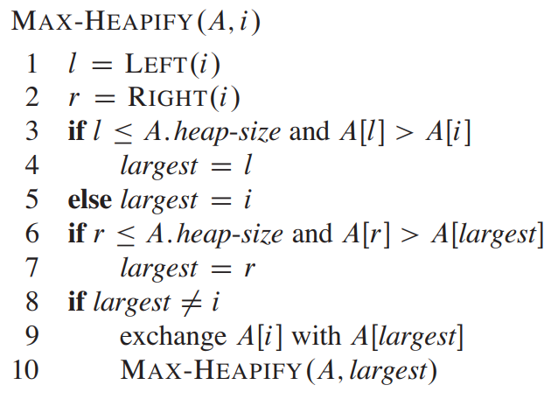
Let us write the function for Max Heapify

Slide 24
Max Heapify
It is TRYING to make the array into a heap
But it may not fully succeed
Let us consider the following example

Slide 25
Max Heapify
It is TRYING to make the array into a heap
But it may not fully succeed
Let us consider the following example
1 | 2 | 3 | 4 | 5 | 6 | 7 | 8 | 9
2 | 7 | 8 | 9 | 2 | 15 | 2 | 2 | 10

Slide 26
Max Heapify
It is TRYING to make the array into a max heap
But it may not fully succeed
Let us consider the following example
1 | 2 | 3 | 4 | 5 | 6 | 7 | 8 | 9
2 | 7 | 8 | 9 | 2 | 15 | 2 | 2 | 10
1
2
3
2
7
8
4
5
6
7
9
2
15
2
8
9
2
10

Slide 27
Max Heapify
It is TRYING to make the array into a max heap
But it may not fully succeed
Let us consider the following example
1 | 2 | 3 | 4 | 5 | 6 | 7 | 8 | 9
2 | 7 | 8 | 9 | 2 | 15 | 2 | 2 | 10
MaxHeapify(A,1)
1
2
3
2
7
8
4
5
6
7
9
2
15
2
8
9
2
10

Slide 28
Max Heapify
It is TRYING to make the array into a max heap
But it may not fully succeed
Let us consider the following example
1 | 2 | 3 | 4 | 5 | 6 | 7 | 8 | 9
2 | 7 | 8 | 9 | 2 | 15 | 2 | 2 | 10
MaxHeapify(A,1)
1
2
3
2
7
8
Largest
4
5
6
7
9
2
15
2
8
9
2
10

Slide 29
Max Heapify
It is TRYING to make the array into a max heap
But it may not fully succeed
Let us consider the following example
1 | 2 | 3 | 4 | 5 | 6 | 7 | 8 | 9
2 | 7 | 8 | 9 | 2 | 15 | 2 | 2 | 10
MaxHeapify(A,1)
1
2
3
2
7
8
Largest
4
5
6
7
9
2
15
2
8
9
2
10

Slide 30
Max Heapify
It is TRYING to make the array into a max heap
But it may not fully succeed
Let us consider the following example
1 | 2 | 3 | 4 | 5 | 6 | 7 | 8 | 9
8 | 7 | 2 | 9 | 2 | 15 | 2 | 2 | 10
MaxHeapify(A,1)
1
8
3
2
7
2
Largest
4
5
6
7
9
2
15
2
8
9
2
10

Slide 31
Max Heapify
It is TRYING to make the array into a max heap
But it may not fully succeed
Let us consider the following example
1 | 2 | 3 | 4 | 5 | 6 | 7 | 8 | 9
8 | 7 | 2 | 9 | 2 | 15 | 2 | 2 | 10
1
8
3
MaxHeapify(A,3)
2
7
2
Largest
4
5
6
7
9
2
15
2
8
9
2
10

Slide 32
Max Heapify
It is TRYING to make the array into a max heap
But it may not fully succeed
Let us consider the following example
1 | 2 | 3 | 4 | 5 | 6 | 7 | 8 | 9
8 | 7 | 2 | 9 | 2 | 15 | 2 | 2 | 10
1
8
3
MaxHeapify(A,3)
2
7
2
4
5
6
7
9
2
15
2
8
9
2
10

Slide 33
Max Heapify
It is TRYING to make the array into a max heap
But it may not fully succeed
Let us consider the following example
1 | 2 | 3 | 4 | 5 | 6 | 7 | 8 | 9
8 | 7 | 2 | 9 | 2 | 15 | 2 | 2 | 10
1
8
3
MaxHeapify(A,3)
2
7
2
4
5
6
7
9
2
15
2
Largest
8
9
2
10

Slide 34
Max Heapify
It is TRYING to make the array into a max heap
But it may not fully succeed
Let us consider the following example
1 | 2 | 3 | 4 | 5 | 6 | 7 | 8 | 9
8 | 7 | 2 | 9 | 2 | 15 | 2 | 2 | 10
1
8
3
MaxHeapify(A,3)
2
7
2
4
5
6
7
9
2
15
2
Largest
8
9
2
10

Slide 35
Max Heapify
It is TRYING to make the array into a max heap
But it may not fully succeed
Let us consider the following example
1 | 2 | 3 | 4 | 5 | 6 | 7 | 8 | 9
8 | 7 | 15 | 9 | 2 | 2 | 2 | 2 | 10
1
8
3
MaxHeapify(A,3)
2
7
15
4
5
6
7
9
2
2
2
Largest
8
9
2
10

Slide 36
Max Heapify
It is TRYING to make the array into a max heap
But it may not fully succeed
Let us consider the following example
1 | 2 | 3 | 4 | 5 | 6 | 7 | 8 | 9
8 | 7 | 15 | 9 | 2 | 2 | 2 | 2 | 10
1
8
3
2
7
15
MaxHeapify(A,6)
4
5
6
7
9
2
2
2
Largest
8
9
2
10

Slide 37
Max Heapify
It is TRYING to make the array into a max heap
But it may not fully succeed
Let us consider the following example
1 | 2 | 3 | 4 | 5 | 6 | 7 | 8 | 9
8 | 7 | 15 | 9 | 2 | 2 | 2 | 2 | 10
1
8
3
2
7
15
IS THIS A MAX HEAP NOW?
4
5
6
7
9
2
2
2
8
9
2
10

Slide 38
Max Heapify
It is TRYING to make the array into a max heap
But it may not fully succeed
Let us consider the following example
1 | 2 | 3 | 4 | 5 | 6 | 7 | 8 | 9
2 | 7 | 8 | 9 | 2 | 15 | 2 | 2 | 10
1
8
No
3
2
7
15
IS THIS A MAX HEAP NOW?
4
5
6
7
9
2
2
2
8
9
2
10

Slide 39
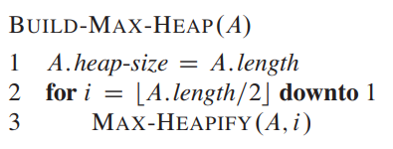
Build Max Heap
Converts an array into a heap

Slide 40
Build Max Heap
Converts an array into a heap
Ensuring that all the elements are on the imaginary tree
Running Max Heapify on all nodes with children

Slide 41
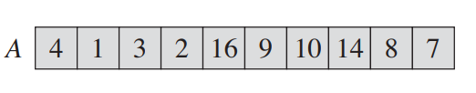
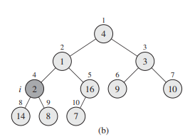
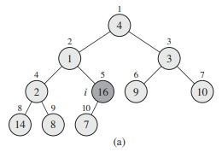
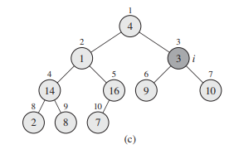
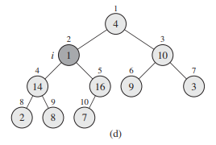
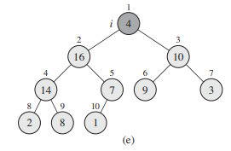
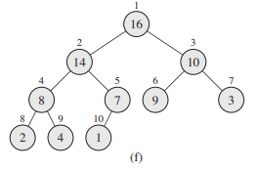
Build Max Heap
Consider the following array

Slide 42
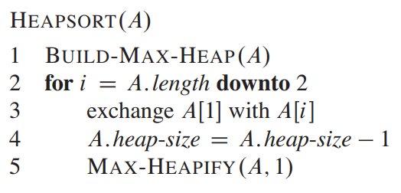
Heap Sort
Parents are larger than children
Build Max Heap
1 | 2 | 3 | 4 | 5 | 6 | 7 | 8 | 9
1 | 2 | 3 | 4 | 5 | 6 | 7 | 8 | 9

Slide 43
Heap Sort
1 | 2 | 3 | 4 | 5 | 6 | 7 | 8 | 9

Slide 44
Heap Sort
1 | 2 | 3 | 4 | 5 | 6 | 7 | 8 | 9

Slide 45
Heap Sort
1 | 2 | 3 | 4 | 5 | 6 | 7 | 8 | 9

Slide 46
Heap Sort
1 | 2 | 3 | 4 | 5 | 6 | 7 | 8 | 9

Slide 47
Heap Sort
1 | 2 | 3 | 4 | 5 | 6 | 7 | 8 | 9

Slide 48
Heap Sort
1 | 2 | 3 | 4 | 5 | 6 | 7 | 8 | 9

Slide 49
Heap Sort
1 | 2 | 3 | 4 | 5 | 6 | 7 | 8 | 9

Slide 50
Heap Sort
1 | 2 | 3 | 4 | 5 | 6 | 7 | 8 | 9

Slide 51
Heap Sort
1 | 2 | 3 | 4 | 5 | 6 | 7 | 8 | 9

Slide 52
Heap Sort
1 | 2 | 3 | 4 | 5 | 6 | 7 | 8 | 9

Slide 53
Heap Sort
1 | 2 | 3 | 4 | 5 | 6 | 7 | 8 | 9

Slide 54
Heap Sort
1 | 2 | 3 | 4 | 5 | 6 | 7 | 8 | 9

Slide 55
Heap Sort
1 | 2 | 3 | 4 | 5 | 6 | 7 | 8 | 9

Slide 56
Heap Sort
MaxHeapify(A,1)
1 | 2 | 3 | 4 | 5 | 6 | 7 | 8 | 9

Slide 57
Heap Sort
1 | 2 | 3 | 4 | 5 | 6 | 7 | 8 | 9

Slide 58
Heap Sort
1 | 2 | 3 | 4 | 5 | 6 | 7 | 8 | 9

Slide 59
Heap Sort
1 | 2 | 3 | 4 | 5 | 6 | 7 | 8 | 9

Slide 60
Heap Sort
1 | 2 | 3 | 4 | 5 | 6 | 7 | 8 | 9

Slide 61
Heap Sort
1 | 2 | 3 | 4 | 5 | 6 | 7 | 8 | 9

Slide 62
Heap Sort
MaxHeapify(A,1)
1 | 2 | 3 | 4 | 5 | 6 | 7 | 8 | 9

Slide 63
Heap Sort
1 | 2 | 3 | 4 | 5 | 6 | 7 | 8 | 9

Slide 64
Heap Sort
1 | 2 | 3 | 4 | 5 | 6 | 7 | 8 | 9

Slide 65
Heap Sort
1 | 2 | 3 | 4 | 5 | 6 | 7 | 8 | 9

Slide 66
Heap Sort
1 | 2 | 3 | 4 | 5 | 6 | 7 | 8 | 9

Slide 67
Heap Sort
MaxHeapify(A,1)
1 | 2 | 3 | 4 | 5 | 6 | 7 | 8 | 9

Slide 68
Heap Sort
MaxHeapify(A,1)
1 | 2 | 3 | 4 | 5 | 6 | 7 | 8 | 9

Slide 69
Heap Sort
MaxHeapify(A,1)
1 | 2 | 3 | 4 | 5 | 6 | 7 | 8 | 9

Slide 70
Heap Sort
MaxHeapify(A,1)
1 | 2 | 3 | 4 | 5 | 6 | 7 | 8 | 9

Slide 71
Heap Sort
MaxHeapify(A,1)
1 | 2 | 3 | 4 | 5 | 6 | 7 | 8 | 9

Slide 72
Heap Sort
MaxHeapify(A,1)
1 | 2 | 3 | 4 | 5 | 6 | 7 | 8 | 9

Slide 73
Let us Run Heap Sort At First

Slide 74
Heap Sort

Slide 75
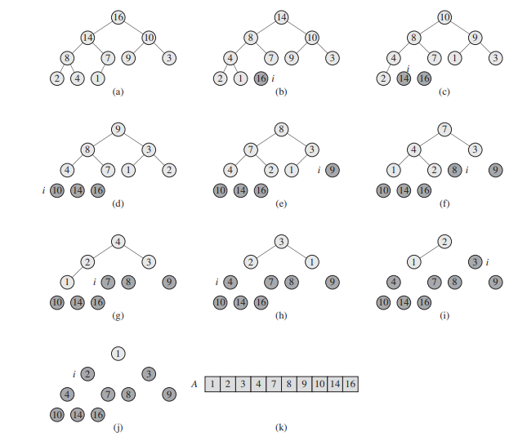
Let us Run Heap Sort At First

Slide 76
MAX HEAP AS A PRIORITY QUEUE

Slide 77
Max heap as a priority queue
Initially the array must
be a max heap (run a max heapify)
Priority Queue functions
HEAP-MAXIMUM
MAX-HEAP-INSERT
HEAP-EXTRACT-MAX
HEAP-INCREASE-KEY
1 | 2 | 3 | 4 | 5 | 6 | 7 | 8 | 9 | 10
16 | 14 | 10 | 8 | 7 | 9 | 3 | 2 | 4 | 1
16
14
10
8
7
9
3
2
4
1

Slide 78
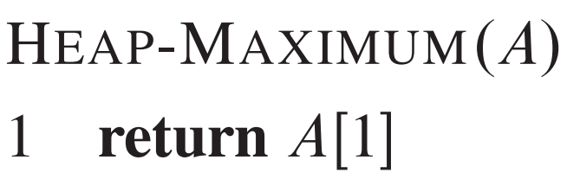
Max heap as a priority queue
Initially the array must
be a max heap (run a max heapify)
Priority Queue functions
HEAP-MAXIMUM – checks what is the age of the eldest citizen
MAX-HEAP-INSERT
HEAP-EXTRACT-MAX
HEAP-INCREASE-KEY
1 | 2 | 3 | 4 | 5 | 6 | 7 | 8 | 9 | 10
16 | 14 | 10 | 8 | 7 | 9 | 3 | 2 | 4 | 1
16
14
10
8
7
9
3
2
4
1

Slide 79
Max heap as a priority queue
Initially the array must
be a max heap (run a max heapify)
Priority Queue functions
HEAP-MAXIMUM
MAX-HEAP-INSERT
HEAP-EXTRACT-MAX – extract the eldest citizen
HEAP-INCREASE-KEY
1 | 2 | 3 | 4 | 5 | 6 | 7 | 8 | 9 | 10
16 | 14 | 10 | 8 | 7 | 9 | 3 | 2 | 4 | 1
16
14
10
8
7
9
3
2
4
1

Slide 80
Max heap as a priority queue
Initially the array must
be a max heap (run a max heapify)
Priority Queue functions
HEAP-MAXIMUM
MAX-HEAP-INSERT
HEAP-EXTRACT-MAX – extract the eldest citizen
HEAP-INCREASE-KEY
1 | 2 | 3 | 4 | 5 | 6 | 7 | 8 | 9 | 10
16 | 14 | 10 | 8 | 7 | 9 | 3 | 2 | 4 | 1
16
1.Swap the last element with the root
14
10
8
7
9
3
2
4
1

Slide 81
Max heap as a priority queue
Initially the array must
be a max heap (run a max heapify)
Priority Queue functions
HEAP-MAXIMUM
MAX-HEAP-INSERT
HEAP-EXTRACT-MAX – extract the eldest citizen
HEAP-INCREASE-KEY
1 | 2 | 3 | 4 | 5 | 6 | 7 | 8 | 9 | 10
1 | 14 | 10 | 8 | 7 | 9 | 3 | 2 | 4 | 16
1
1.Swap the last element with the root
14
10
8
7
9
3
2
4
16

Slide 82
Max heap as a priority queue
Initially the array must
be a max heap (run a max heapify)
Priority Queue functions
HEAP-MAXIMUM
MAX-HEAP-INSERT
HEAP-EXTRACT-MAX – extract the eldest citizen
HEAP-INCREASE-KEY
1 | 2 | 3 | 4 | 5 | 6 | 7 | 8 | 9 | 10
1 | 14 | 10 | 8 | 7 | 9 | 3 | 2 | 4 | 16
1
1.Swap the last element with the root
2.Remove the largest element
14
10
8
7
9
3
2
4
16

Slide 83
Max heap as a priority queue
Initially the array must
be a max heap (run a max heapify)
Priority Queue functions
HEAP-MAXIMUM
MAX-HEAP-INSERT
HEAP-EXTRACT-MAX – extract the eldest citizen
HEAP-INCREASE-KEY
1 | 2 | 3 | 4 | 5 | 6 | 7 | 8 | 9 | 10
16 | 14 | 10 | 8 | 7 | 9 | 3 | 2 | 4 | 1
1 | 2 | 3 | 4 | 5 | 6 | 7 | 8 | 9 | 10
1 | 14 | 10 | 8 | 7 | 9 | 3 | 2 | 4 | 16
1
Heap Size
1.Swap the last element with the root
2.Remove the largest element
14
10
8
7
9
3
2
4
16

Slide 84
Max heap as a priority queue
Initially the array must
be a max heap (run a max heapify)
Priority Queue functions
HEAP-MAXIMUM
MAX-HEAP-INSERT
HEAP-EXTRACT-MAX – extract the eldest citizen
HEAP-INCREASE-KEY
1 | 2 | 3 | 4 | 5 | 6 | 7 | 8 | 9 | 10
16 | 14 | 10 | 8 | 7 | 9 | 3 | 2 | 4 | 1
1 | 2 | 3 | 4 | 5 | 6 | 7 | 8 | 9 | 10
1 | 14 | 10 | 8 | 7 | 9 | 3 | 2 | 4 | 16
1
Heap Size
1.Swap the last element with the root
2.Remove the largest element
3.Run a max heapify
14
10
8
7
9
3
2
4
16

Slide 85
Max heap as a priority queue
Initially the array must
be a max heap (run a max heapify)
Priority Queue functions
HEAP-MAXIMUM
MAX-HEAP-INSERT
HEAP-EXTRACT-MAX – extract the eldest citizen
HEAP-INCREASE-KEY
1 | 2 | 3 | 4 | 5 | 6 | 7 | 8 | 9 | 10
16 | 14 | 10 | 8 | 7 | 9 | 3 | 2 | 4 | 1
1 | 2 | 3 | 4 | 5 | 6 | 7 | 8 | 9 | 10
1 | 14 | 10 | 8 | 7 | 9 | 3 | 2 | 4 | 16
1
Heap Size
1.Swap the last element with the root
2.Remove the largest element
3.Run a max heapify
14
10
8
7
9
3
2
4
16

Slide 86
Max heap as a priority queue
Initially the array must
be a max heap (run a max heapify)
Priority Queue functions
HEAP-MAXIMUM
MAX-HEAP-INSERT
HEAP-EXTRACT-MAX – extract the eldest citizen
HEAP-INCREASE-KEY
1 | 2 | 3 | 4 | 5 | 6 | 7 | 8 | 9 | 10
16 | 14 | 10 | 8 | 7 | 9 | 3 | 2 | 4 | 1
1 | 2 | 3 | 4 | 5 | 6 | 7 | 8 | 9 | 10
14 | 1 | 10 | 8 | 7 | 9 | 3 | 2 | 4 | 16
14
Heap Size
1.Swap the last element with the root
2.Remove the largest element
3.Run a max heapify
1
10
8
7
9
3
2
4
16

Slide 87
Max heap as a priority queue
Initially the array must
be a max heap (run a max heapify)
Priority Queue functions
HEAP-MAXIMUM
MAX-HEAP-INSERT
HEAP-EXTRACT-MAX – extract the eldest citizen
HEAP-INCREASE-KEY
1 | 2 | 3 | 4 | 5 | 6 | 7 | 8 | 9 | 10
16 | 14 | 10 | 8 | 7 | 9 | 3 | 2 | 4 | 1
1 | 2 | 3 | 4 | 5 | 6 | 7 | 8 | 9 | 10
14 | 1 | 10 | 8 | 7 | 9 | 3 | 2 | 4 | 16
14
Heap Size
1.Swap the last element with the root
2.Remove the largest element
3.Run a max heapify
1
10
8
7
9
3
2
4
16

Slide 88
Max heap as a priority queue
Initially the array must
be a max heap (run a max heapify)
Priority Queue functions
HEAP-MAXIMUM
MAX-HEAP-INSERT
HEAP-EXTRACT-MAX – extract the eldest citizen
HEAP-INCREASE-KEY
1 | 2 | 3 | 4 | 5 | 6 | 7 | 8 | 9 | 10
16 | 14 | 10 | 8 | 7 | 9 | 3 | 2 | 4 | 1
1 | 2 | 3 | 4 | 5 | 6 | 7 | 8 | 9 | 10
14 | 8 | 10 | 1 | 7 | 9 | 3 | 2 | 4 | 16
14
Heap Size
1.Swap the last element with the root
2.Remove the largest element
3.Run a max heapify
8
10
1
7
9
3
2
4
16

Slide 89
Max heap as a priority queue
Initially the array must
be a max heap (run a max heapify)
Priority Queue functions
HEAP-MAXIMUM
MAX-HEAP-INSERT
HEAP-EXTRACT-MAX – extract the eldest citizen
HEAP-INCREASE-KEY
1 | 2 | 3 | 4 | 5 | 6 | 7 | 8 | 9 | 10
16 | 14 | 10 | 8 | 7 | 9 | 3 | 2 | 4 | 1
1 | 2 | 3 | 4 | 5 | 6 | 7 | 8 | 9 | 10
14 | 8 | 10 | 1 | 7 | 9 | 3 | 2 | 4 | 16
14
Heap Size
1.Swap the last element with the root
2.Remove the largest element
3.Run a max heapify
8
10
1
7
9
3
2
4
16

Slide 90
Max heap as a priority queue
Initially the array must
be a max heap (run a max heapify)
Priority Queue functions
HEAP-MAXIMUM
MAX-HEAP-INSERT
HEAP-EXTRACT-MAX – extract the eldest citizen
HEAP-INCREASE-KEY
1 | 2 | 3 | 4 | 5 | 6 | 7 | 8 | 9 | 10
16 | 14 | 10 | 8 | 7 | 9 | 3 | 2 | 4 | 1
1 | 2 | 3 | 4 | 5 | 6 | 7 | 8 | 9 | 10
14 | 8 | 10 | 4 | 7 | 9 | 3 | 2 | 1 | 16
14
Heap Size
1.Swap the last element with the root
2.Remove the largest element
3.Run a max heapify
8
10
4
7
9
3
2
1
16

Slide 91
Max heap as a priority queue
Initially the array must
be a max heap (run a max heapify)
Priority Queue functions
HEAP-MAXIMUM
MAX-HEAP-INSERT
HEAP-EXTRACT-MAX – extract the eldest citizen
HEAP-INCREASE-KEY
1 | 2 | 3 | 4 | 5 | 6 | 7 | 8 | 9 | 10
16 | 14 | 10 | 8 | 7 | 9 | 3 | 2 | 4 | 1
1 | 2 | 3 | 4 | 5 | 6 | 7 | 8 | 9 | 10
14 | 8 | 10 | 4 | 7 | 9 | 3 | 2 | 1 | 16
14
Heap Size
1.Swap the last element with the root
2.Remove the largest element
3.Run a max heapify
Observe that it is still a max heap
8
10
4
7
9
3
2
1
16

Slide 92
Max heap as a priority queue
Initially the array must
be a max heap (run a max heapify)
Priority Queue functions
HEAP-MAXIMUM
MAX-HEAP-INSERT
HEAP-EXTRACT-MAX – extract the eldest citizen
HEAP-INCREASE-KEY
1 | 2 | 3 | 4 | 5 | 6 | 7 | 8 | 9 | 10
16 | 14 | 10 | 8 | 7 | 9 | 3 | 2 | 4 | 1
1 | 2 | 3 | 4 | 5 | 6 | 7 | 8 | 9 | 10
14 | 8 | 10 | 4 | 7 | 9 | 3 | 2 | 1 | 16
14
Heap Size
1.Swap the last element with the root
2.Remove the largest element
3.Run a max heapify
Observe that it is still a max heap
4. Return A[heapsize+1]
8
10
4
7
9
3
2
1
16

Slide 93
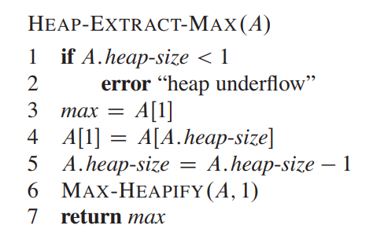
Max heap as a priority queue
Initially the array must
be a max heap (run a max heapify)
Priority Queue functions
HEAP-MAXIMUM
MAX-HEAP-INSERT
HEAP-EXTRACT-MAX – extract the eldest citizen
HEAP-INCREASE-KEY
1 | 2 | 3 | 4 | 5 | 6 | 7 | 8 | 9 | 10
16 | 14 | 10 | 8 | 7 | 9 | 3 | 2 | 4 | 1
1 | 2 | 3 | 4 | 5 | 6 | 7 | 8 | 9 | 10
14 | 8 | 10 | 4 | 7 | 9 | 3 | 2 | 1 | 16
14
1.Swap the last element with the root
2.Remove the largest element
3.Run a max heapify
Observe that it is still a max heap
4. Return A[heapsize+1]
8
10
4
7
9
3
2
1
16

Slide 94
Max heap as a priority queue
Initially the array must
be a max heap (run a max heapify)
Priority Queue functions
HEAP-MAXIMUM
MAX-HEAP-INSERT
HEAP-EXTRACT-MAX – extract the eldest citizen
HEAP-INCREASE-KEY
1 | 2 | 3 | 4 | 5 | 6 | 7 | 8 | 9 | 10
16 | 14 | 10 | 8 | 7 | 9 | 3 | 2 | 4 | 1
1 | 2 | 3 | 4 | 5 | 6 | 7 | 8 | 9 | 10
14 | 8 | 10 | 4 | 7 | 9 | 3 | 2 | 1 | 16
Takes O(logn time)
14
1.Swap the last element with the root
2.Remove the largest element
3.Run a max heapify
Observe that it is still a max heap
4. Return A[heapsize+1]
8
10
4
7
9
3
2
1
16
O(logn)

Slide 95
Priority Queue functions
HEAP-MAXIMUM
MAX-HEAP-INSERT
HEAP-EXTRACT-MAX
HEAP-INCREASE-KEY – increase the value of a particular index
1 | 2 | 3 | 4 | 5 | 6 | 7 | 8 | 9 | 10
16 | 14 | 10 | 8 | 7 | 9 | 3 | 2 | 4 | 1
16
14
10
8
7
9
3
2
4
1

Slide 96
HeapIncreaseKey(A,10,90)
Priority Queue functions
HEAP-MAXIMUM
MAX-HEAP-INSERT
HEAP-EXTRACT-MAX
HEAP-INCREASE-KEY – increase the value of a particular index
1 | 2 | 3 | 4 | 5 | 6 | 7 | 8 | 9 | 10
16 | 14 | 10 | 8 | 7 | 9 | 3 | 2 | 4 | 1
Place the new value at the index
While the selected index is not a root and is greater than parent
Change the values with parent
The parent is now the selected index
16
14
10
8
7
9
3
2
4
90

Slide 97
HeapIncreaseKey(A,10,90)
Priority Queue functions
HEAP-MAXIMUM
MAX-HEAP-INSERT
HEAP-EXTRACT-MAX
HEAP-INCREASE-KEY – increase the value of a particular index
1 | 2 | 3 | 4 | 5 | 6 | 7 | 8 | 9 | 10
16 | 14 | 10 | 8 | 7 | 9 | 3 | 2 | 4 | 1
Place the new value at the index
While the selected index is not a root and is greater than parent
Change the values with parent
The parent is now the selected index
16
14
10
8
90
9
3
2
4
7

Slide 98
HeapIncreaseKey(A,10,90)
Priority Queue functions
HEAP-MAXIMUM
MAX-HEAP-INSERT
HEAP-EXTRACT-MAX
HEAP-INCREASE-KEY – increase the value of a particular index
1 | 2 | 3 | 4 | 5 | 6 | 7 | 8 | 9 | 10
16 | 14 | 10 | 8 | 7 | 9 | 3 | 2 | 4 | 1
Place the new value at the index
While the selected index is not a root and is greater than parent
Change the values with parent
The parent is now the selected index
16
14
10
8
90
9
3
2
4
7

Slide 99
HeapIncreaseKey(A,10,90)
Priority Queue functions
HEAP-MAXIMUM
MAX-HEAP-INSERT
HEAP-EXTRACT-MAX
HEAP-INCREASE-KEY – increase the value of a particular index
1 | 2 | 3 | 4 | 5 | 6 | 7 | 8 | 9 | 10
16 | 14 | 10 | 8 | 7 | 9 | 3 | 2 | 4 | 1
Place the new value at the index
While the selected index is not a root and is greater than parent
Change the values with parent
The parent is now the selected index
16
90
10
8
14
9
3
2
4
7

Slide 100
HeapIncreaseKey(A,10,90)
Priority Queue functions
HEAP-MAXIMUM
MAX-HEAP-INSERT
HEAP-EXTRACT-MAX
HEAP-INCREASE-KEY – increase the value of a particular index
1 | 2 | 3 | 4 | 5 | 6 | 7 | 8 | 9 | 10
16 | 14 | 10 | 8 | 7 | 9 | 3 | 2 | 4 | 1
Place the new value at the index
While the selected index is not a root and is greater than parent
Change the values with parent
The parent is now the selected index
16
90
10
8
14
9
3
2
4
7

Slide 101
HeapIncreaseKey(A,10,90)
Priority Queue functions
HEAP-MAXIMUM
MAX-HEAP-INSERT
HEAP-EXTRACT-MAX
HEAP-INCREASE-KEY – increase the value of a particular index
1 | 2 | 3 | 4 | 5 | 6 | 7 | 8 | 9 | 10
16 | 14 | 10 | 8 | 7 | 9 | 3 | 2 | 4 | 1
Place the new value at the index
While the selected index is not a root and is greater than parent
Change the values with parent
The parent is now the selected index
90
16
10
8
14
9
3
2
4
7

Slide 102
HeapIncreaseKey(A,10,90)
Priority Queue functions
HEAP-MAXIMUM
MAX-HEAP-INSERT
HEAP-EXTRACT-MAX
HEAP-INCREASE-KEY – increase the value of a particular index
1 | 2 | 3 | 4 | 5 | 6 | 7 | 8 | 9 | 10
16 | 14 | 10 | 8 | 7 | 9 | 3 | 2 | 4 | 1
Place the new value at the index
While the selected index is not a root and is greater than parent
Change the values with parent
The parent is now the selected index
90
16
10
8
14
9
3
2
4
7

Slide 103
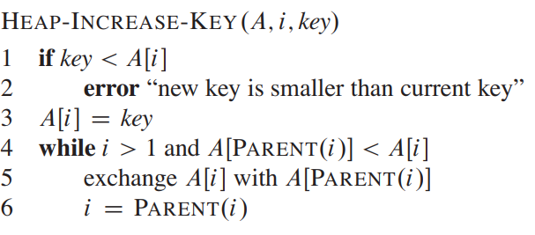
HeapIncreaseKey(A,10,90)
Priority Queue functions
HEAP-MAXIMUM
MAX-HEAP-INSERT
HEAP-EXTRACT-MAX
HEAP-INCREASE-KEY – increase the value of a particular index
1 | 2 | 3 | 4 | 5 | 6 | 7 | 8 | 9 | 10
16 | 14 | 10 | 8 | 7 | 9 | 3 | 2 | 4 | 1
90
16
10
8
14
9
3
2
4
7

Slide 104
HeapIncreaseKey(A,10,90)
Priority Queue functions
HEAP-MAXIMUM
MAX-HEAP-INSERT
HEAP-EXTRACT-MAX
HEAP-INCREASE-KEY – increase the value of a particular index
1 | 2 | 3 | 4 | 5 | 6 | 7 | 8 | 9 | 10
16 | 14 | 10 | 8 | 7 | 9 | 3 | 2 | 4 | 1
90
16
10
8
14
9
3
2
4
7
Climbs the height of the tree – O(logn) time

Slide 105
Max heap as a priority queue
Initially the array must
be a max heap (run a max heapify)
Priority Queue functions
HEAP-MAXIMUM
MAX-HEAP-INSERT
HEAP-EXTRACT-MAX
HEAP-INCREASE-KEY
1 | 2 | 3 | 4 | 5 | 6 | 7 | 8 | 9 | 10
16 | 14 | 10 | 8 | 7 | 9 | 3 | 2 | 4 | 1
16
14
10
8
7
9
3
2
4
1

Slide 106
Max heap as a priority queue
Priority Queue functions
HEAP-MAXIMUM
MAX-HEAP-INSERT
HEAP-EXTRACT-MAX
HEAP-INCREASE-KEY
Heap Increase Key (A, heapsize, new value)
1 | 2 | 3 | 4 | 5 | 6 | 7 | 8 | 9 | 10 | 11
16 | 14 | 10 | 8 | 7 | 9 | 3 | 2 | 4 | 1 | -inf
16
14
10
8
7
9
3
2
4
1
-INF

Slide 107
Max heap as a priority queue
Priority Queue functions
HEAP-MAXIMUM
MAX-HEAP-INSERT
HEAP-EXTRACT-MAX
HEAP-INCREASE-KEY
Heap Increase Key (A, heapsize, new value)
1 | 2 | 3 | 4 | 5 | 6 | 7 | 8 | 9 | 10 | 11
16 | 14 | 10 | 8 | 7 | 9 | 3 | 2 | 4 | 1 | -inf
16
14
10
8
7
9
3
2
4
1
15

Slide 108
Max heap as a priority queue
Priority Queue functions
HEAP-MAXIMUM
MAX-HEAP-INSERT
HEAP-EXTRACT-MAX
HEAP-INCREASE-KEY
Heap Increase Key (A, heapsize, new value)
1 | 2 | 3 | 4 | 5 | 6 | 7 | 8 | 9 | 10 | 11
16 | 14 | 10 | 8 | 7 | 9 | 3 | 2 | 4 | 1 | -inf
16
14
10
8
15
9
3
2
4
1
7

Slide 109
Max heap as a priority queue
Priority Queue functions
HEAP-MAXIMUM
MAX-HEAP-INSERT
HEAP-EXTRACT-MAX
HEAP-INCREASE-KEY
Heap Increase Key (A, heapsize, new value)
1 | 2 | 3 | 4 | 5 | 6 | 7 | 8 | 9 | 10 | 11
16 | 14 | 10 | 8 | 7 | 9 | 3 | 2 | 4 | 1 | -inf
16
14
10
8
15
9
3
2
4
1
7

Slide 110
Max heap as a priority queue
Priority Queue functions
HEAP-MAXIMUM
MAX-HEAP-INSERT
HEAP-EXTRACT-MAX
HEAP-INCREASE-KEY
Heap Increase Key (A, heapsize, new value)
1 | 2 | 3 | 4 | 5 | 6 | 7 | 8 | 9 | 10 | 11
16 | 14 | 10 | 8 | 7 | 9 | 3 | 2 | 4 | 1 | -inf
16
15
10
8
14
9
3
2
4
1
7

Slide 111
Max heap as a priority queue
Priority Queue functions
HEAP-MAXIMUM
MAX-HEAP-INSERT
HEAP-EXTRACT-MAX
HEAP-INCREASE-KEY
Heap Increase Key (A, heapsize, new value)
1 | 2 | 3 | 4 | 5 | 6 | 7 | 8 | 9 | 10 | 11
16 | 14 | 10 | 8 | 7 | 9 | 3 | 2 | 4 | 1 | -inf
16
15
10
8
14
9
3
2
4
1
7

Slide 112
Max heap as a priority queue
Priority Queue functions
HEAP-MAXIMUM
MAX-HEAP-INSERT
HEAP-EXTRACT-MAX
HEAP-INCREASE-KEY
Heap Increase Key (A, heapsize, new value)
1 | 2 | 3 | 4 | 5 | 6 | 7 | 8 | 9 | 10 | 11
16 | 14 | 10 | 8 | 7 | 9 | 3 | 2 | 4 | 1 | -inf
16
15
10
Time?
Takes O(logn) time
8
14
9
3
2
4
1
7

Slide 113
Task (Ungraded)
Perform all the simulations by hand.
Implement all the functions of the heap yourselves.
The pseudo codes are given in the slides - use them if needed, but try to code based on your understanding first.

Slide 114
Thank You

